Slide 1
Seller
Property
Buyer
HomePage
Register Seller form (comp)
Add Property (comp)
Register Buyer form (comp)
Nav com
Display Seller Card Component
Display Card Component
button (useState)
Withdraw property
Resubmit property
Display Buyer Card (comp)
Json file
Context component
Find Property Component Filter
Price
bedrooms
bathroom
garden.

Slide 2
Nav Bar
Home Page Seller Buyer

Slide 3
Seller
NAVBAR
Button to add sellers submit to json
Display all sellers – table
Seller
id
FirstName
Surname
Add seller form
Input First Name
Input Second Name
Notes:
3

Slide 4
Buyer
NAVBAR
Button to add buyer submit to json
Display all Buyer – table
Buyer
id
FirstName
Surname
Add buyer form
Input First Name
Input Second Name
Notes:
4

Slide 5
Home Page/Properties
NAVBAR
price range
bedroom,
Add Property link
Find properties component
Filter (bathroom)
Filter (garden)
Add Property
Name (string)
Photo (url)
Price (number)
Bedrooms (number)
Bathroom (number)
Garden (yes / no)
Property card component (unique id)
Name (string)
Photo (url)
Price (number)
Bedrooms (number)
Bathroom (number)
Garden (yes / no)
Display properties component
(placeholder for cards to sit in)
Withdraw/resubmit
toggle
Notes:
5

Slide 6
JSON File
Property
- id
Name (string)
Photo (url)
Price (number)
Bedrooms (number)
Bathroom (number)
Garden (yes / no)
Status (for sale, sold, withdrawn)
Customer
id
FirstName
Surname
Type

Slide 7
Home Page
NAVBAR
Random content
Random content
buyers
properties
sellers
Random content
Notes:
7

Slide 8
Background colour: rgb(216,221,214) to rgb(71,96,100)
LOGO
CHEESY SLOGAN GOES HERE
NAVBAR

Slide 9
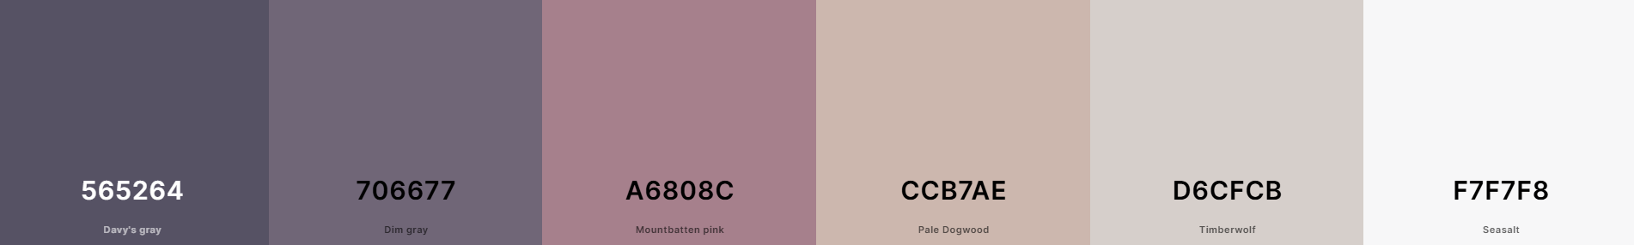
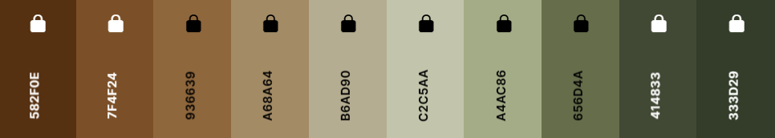
/* SCSS Gradient */
$gradient-top: linear-gradient(0deg, #565264ff, #706677ff, #a6808cff, #ccb7aeff, #d6cfcbff, #F7F7F8ff);
$gradient-right: linear-gradient(90deg, #565264ff, #706677ff, #a6808cff, #ccb7aeff, #d6cfcbff, #F7F7F8ff);
$gradient-bottom: linear-gradient(180deg, #565264ff, #706677ff, #a6808cff, #ccb7aeff, #d6cfcbff, #F7F7F8ff);
$gradient-left: linear-gradient(270deg, #565264ff, #706677ff, #a6808cff, #ccb7aeff, #d6cfcbff, #F7F7F8ff);
$gradient-top-right: linear-gradient(45deg, #565264ff, #706677ff, #a6808cff, #ccb7aeff, #d6cfcbff, #F7F7F8ff);
$gradient-bottom-right: linear-gradient(135deg, #565264ff, #706677ff, #a6808cff, #ccb7aeff, #d6cfcbff, #F7F7F8ff);
$gradient-top-left: linear-gradient(225deg, #565264ff, #706677ff, #a6808cff, #ccb7aeff, #d6cfcbff, #F7F7F8ff);
$gradient-bottom-left: linear-gradient(315deg, #565264ff, #706677ff, #a6808cff, #ccb7aeff, #d6cfcbff, #F7F7F8ff);
$gradient-radial: radial-gradient(#565264ff, #706677ff, #a6808cff, #ccb7aeff, #d6cfcbff, #F7F7F8ff);
/* CSS HEX */
--davys-gray: #565264;
--dim-gray: #706677;
--mountbatten-pink: #A6808C;
--pale-dogwood: #CCB7AE;
--timberwolf: #D6CFCB;
--seasalt: #F7F7F8;

